Slide 1
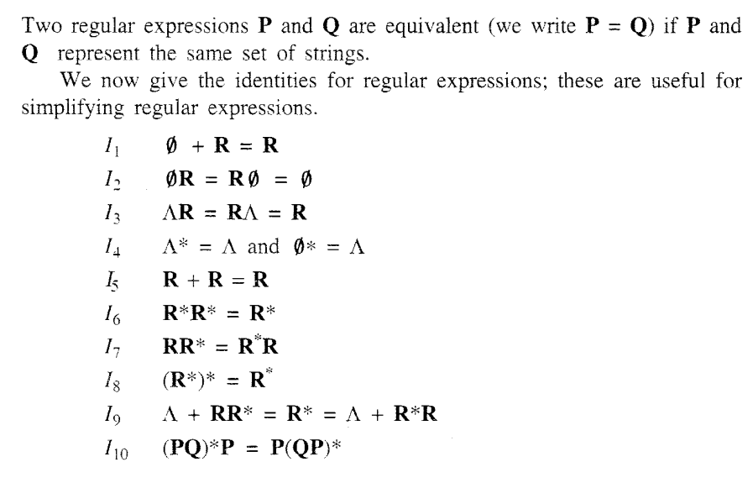
Identity Rules

Slide 2
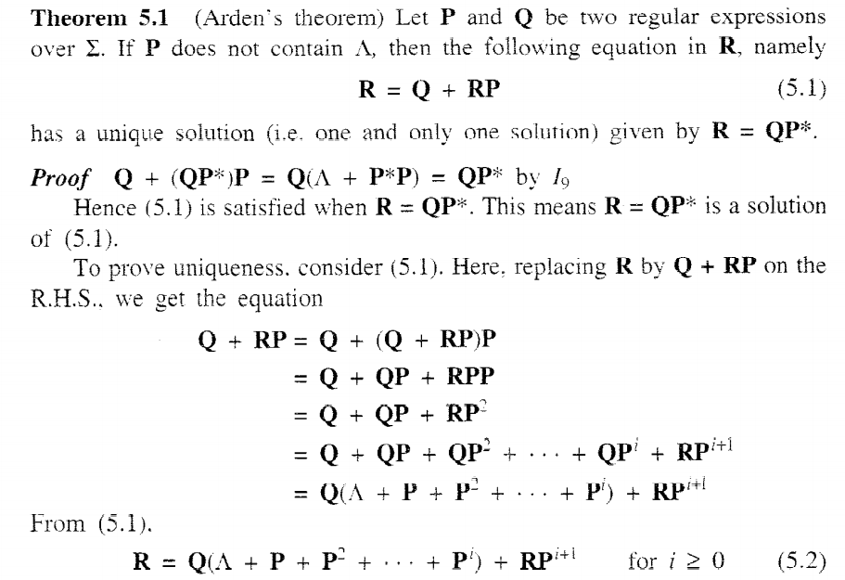
Arden’s Theorem

Slide 3
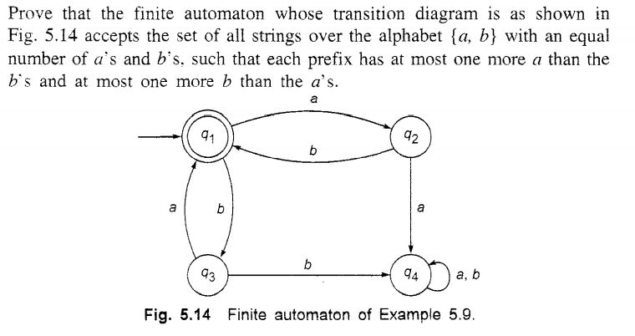
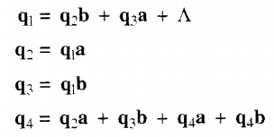
Converting Finite Automata to Regular Expression

Slide 4
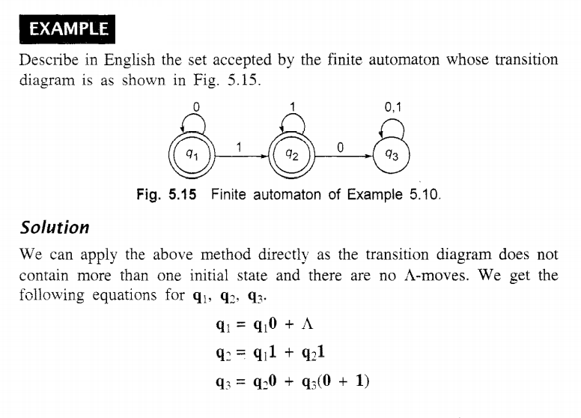
Converting Finite Automata to Regular Expression

Slide 5
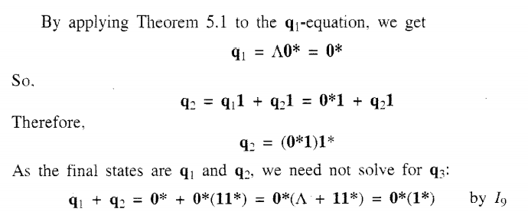
Converting Finite Automata to Regular Expression

Slide 6
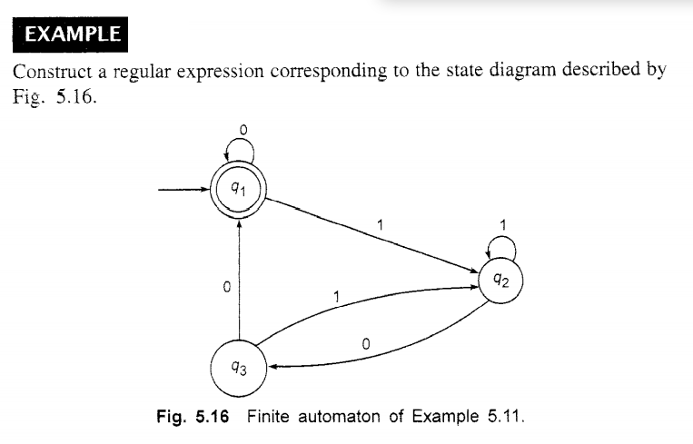
Converting Finite Automata to Regular Expression

Slide 7
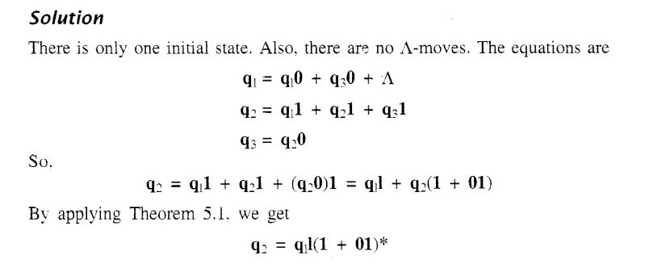
Converting Finite Automata to Regular Expression

Slide 8
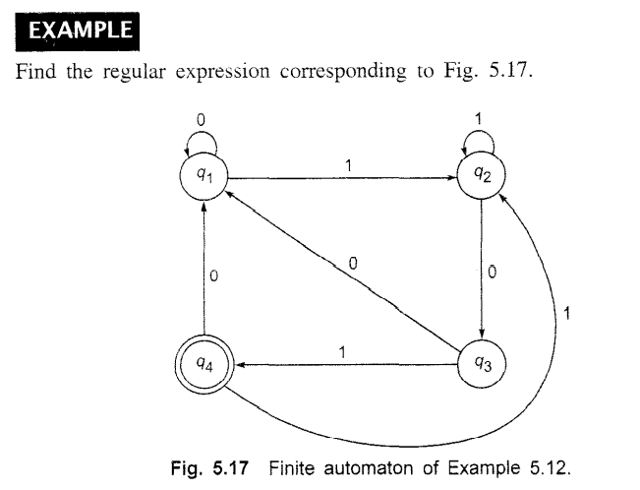
Converting Finite Automata to Regular Expression

Slide 9
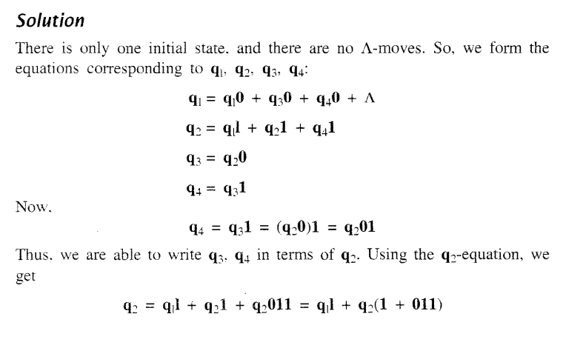
Converting Finite Automata to Regular Expression

Slide 10
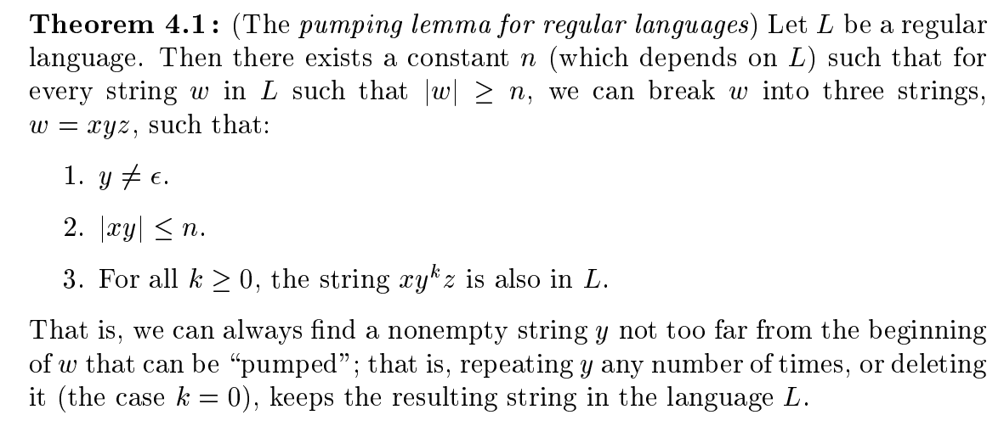
Pumping Lemma of Regular Sets (Or Regular Languages)

Slide 11
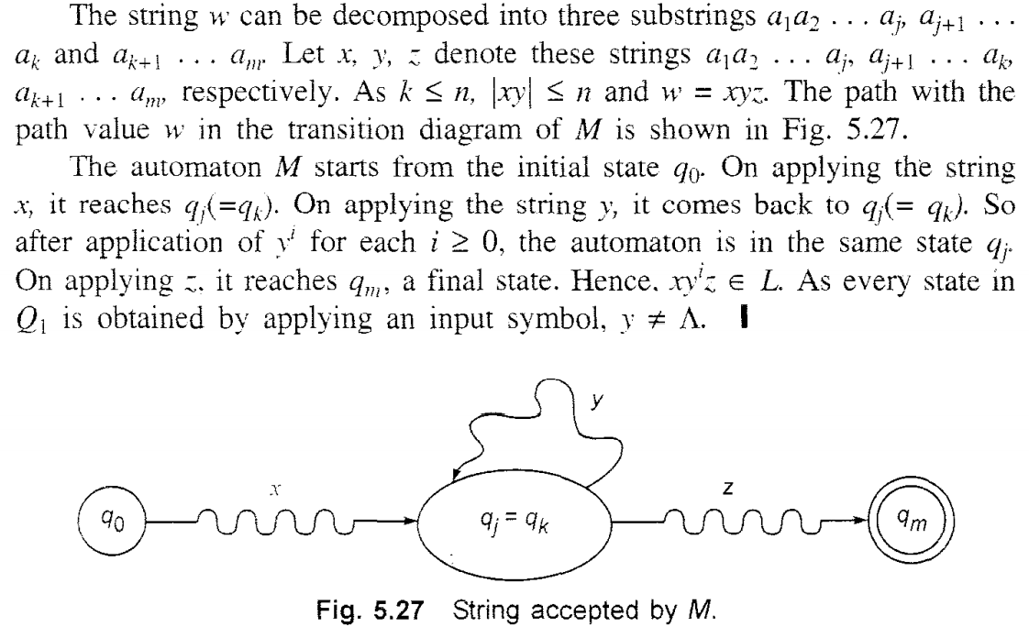
Pumping Lemma of Regular Sets (Or Regular Languages)

Slide 12
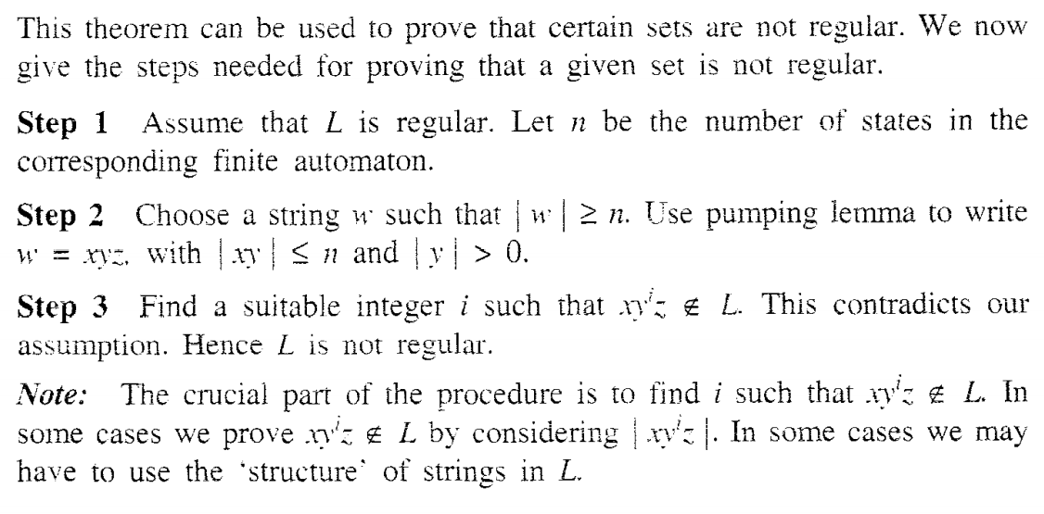
Applications of Pumping Lemma

Slide 13
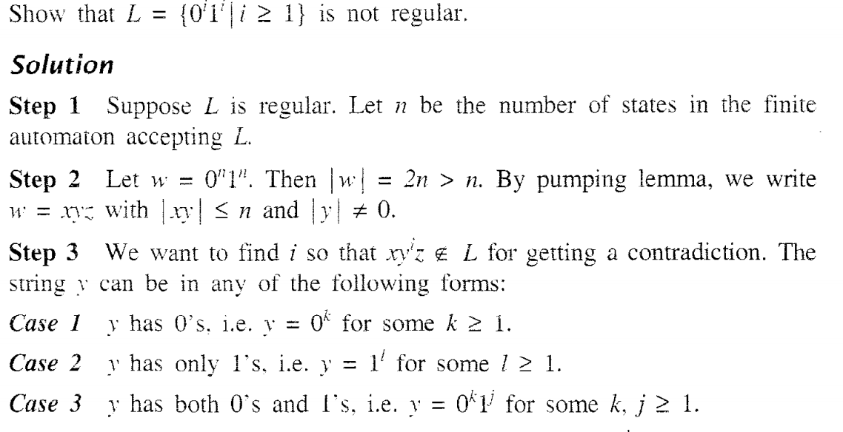
Pumping Lemma of Regular Sets (Or Regular Languages)

Slide 14
Pumping Lemma of Regular Sets (Or Regular Languages)

Slide 15
Pumping Lemma of Regular Sets (Or Regular Languages)

Slide 16
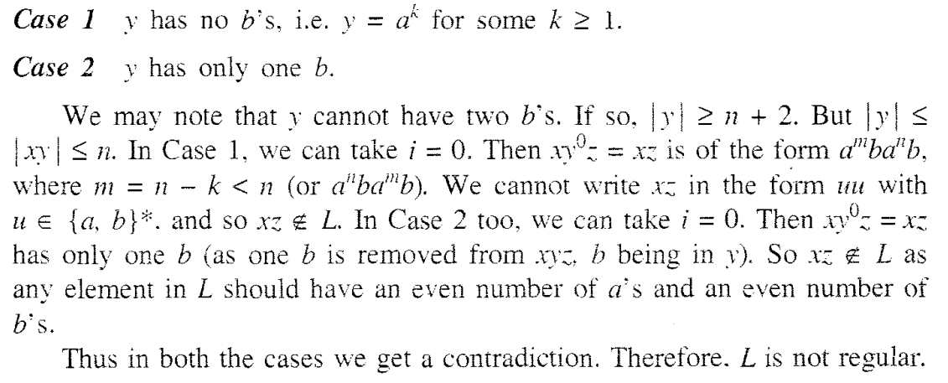
Pumping Lemma of Regular Sets (Or Regular Languages)

Slide 17
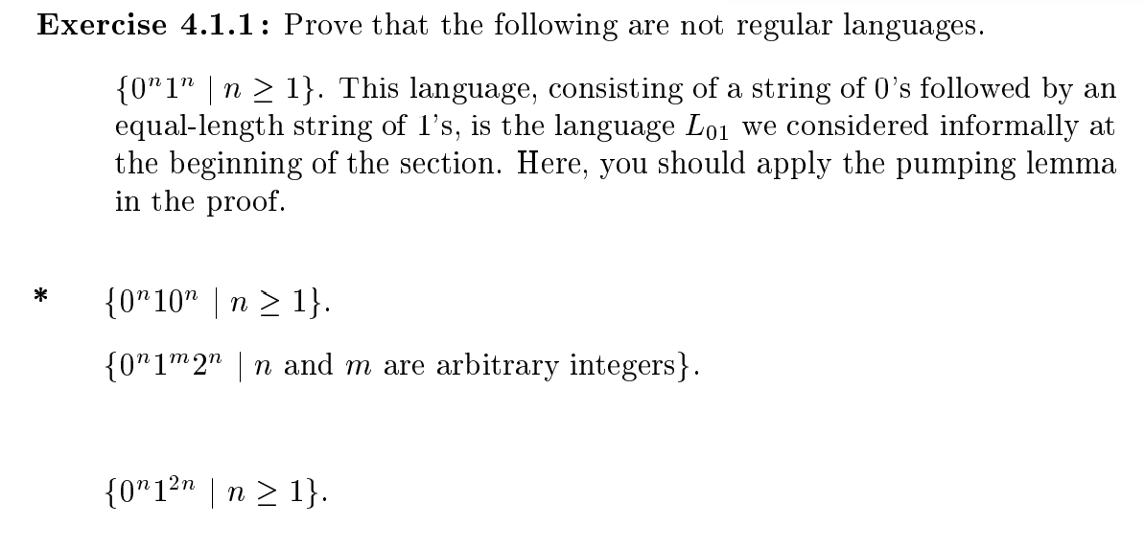
Pumping Lemma of Regular Sets (Or Regular Languages)

Slide 18
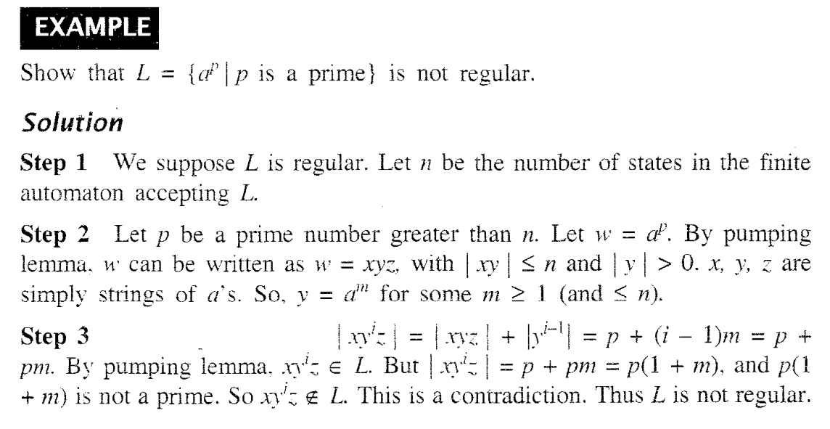
Pumping Lemma of Regular Sets (Or Regular Languages)

Slide 19
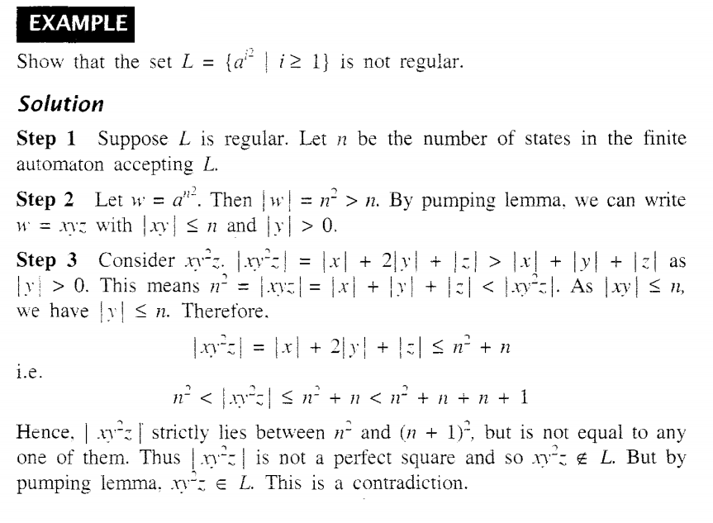
Pumping Lemma of Regular Sets (Or Regular Languages)

Slide 20
Problems : Find Finite Automata for the Regular Expressions
Construct the finite automaton equivalent to the regular expressions
aa
a*
a+b
aa+bb
ab+ba+ca
(a+b)*
(a+b)*aa
(a+b)*aa(a+b)*
(a+b)* (aa+ba) (a+b)*
(0 + 1)*(00 + 11)(0 + 1)*
(a+b+c)*ab(a+b+c)*
Construct a finite automaton accepting all strings over {0, 1} ending in 010 or 0010
Φ
Є
a

Slide 21
Problems є -NFA for the regular expressions
Construct the є -NFA for the regular expressions
aa
a*
a+b
aa+bb
ab+ba+ca
(a+b)*
(a+b)*aa
(a+b)*aa(a+b)*
(a+b)* (aa+ba) (a+b)*
(0 + 1)*(00 + 11)(0 + 1)*
(a+b+c)*ab(a+b+c)*

Slide 22
Problems : Find null-NFA for the regular expressions
Construct the є -NFA for the regular expressions
aa
a*
a+b
aa+bb
ab+ba+ca
(a+b)*
(a+b)*aa
(a+b)*aa(a+b)*
(a+b)* (aa+ba) (a+b)*
(0 + 1)*(00 + 11)(0 + 1)*
(a+b+c)*ab(a+b+c)*

Slide 23
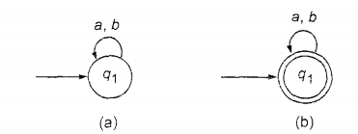
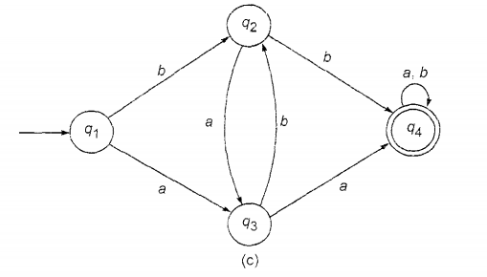
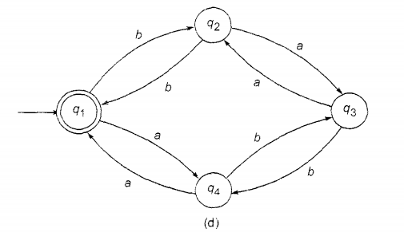
Problems: FA to RE
Find the regular expression for the following finite automata

Slide 24
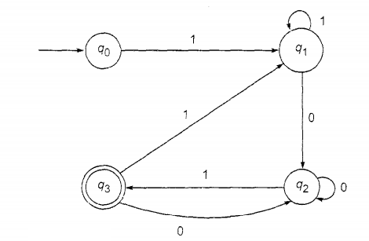
Find the regular expression for the following finite automata

